Slide 1
Introducing Employee Online
By the Auditor-Controllers Office

Slide 2
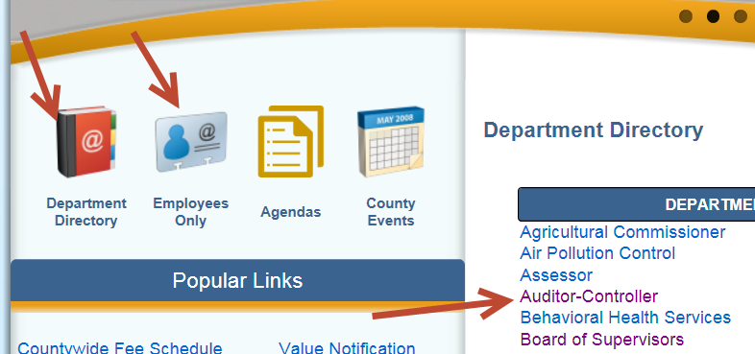
How To Access Employee Online
Employee Online Setup
There are currently two links available to enter into employee online on the County of Imperial’s webpage:
Thru the Employees Only link (Not available for extra help)
Thru the Auditor Controllers Office which you can locate via the Department Directory. (Available to all employees)

Slide 3
Click on the Employee online link
Employee Online link

Slide 4
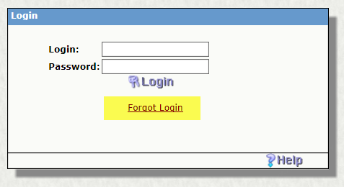
How to Login
Login: Use your employee ID
Password:
For employees hired prior to October 2015
the first time you log in your password will be your SSN.
For employees hired after October 1, 2015 your password will be the last 4 digits of your SSN.
Also if you forget your password this is where you can reset it if you have an email address on your profile.

Slide 5
Password Setup
*(If you forget or lose your password use the forgot login and enter the email address that you entered on your Home Address link or contact the Auditor’s Office to have it reset)

Slide 6
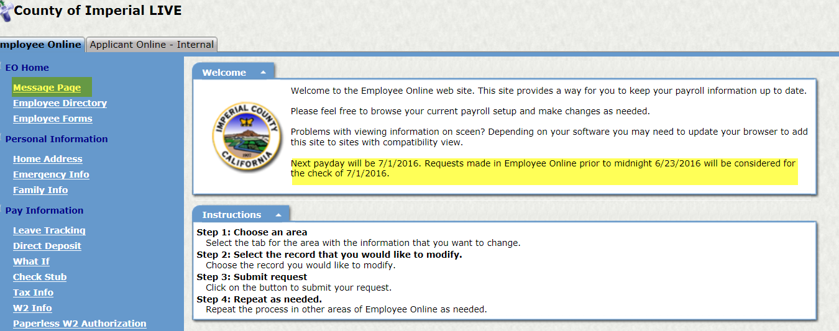
EO HOME
Message Page
When you log into Employee Online you are brought to the Message Page.
This is where you can find out what your next payday will be
&
cutoff times for requests submitted on employee online.

Slide 7
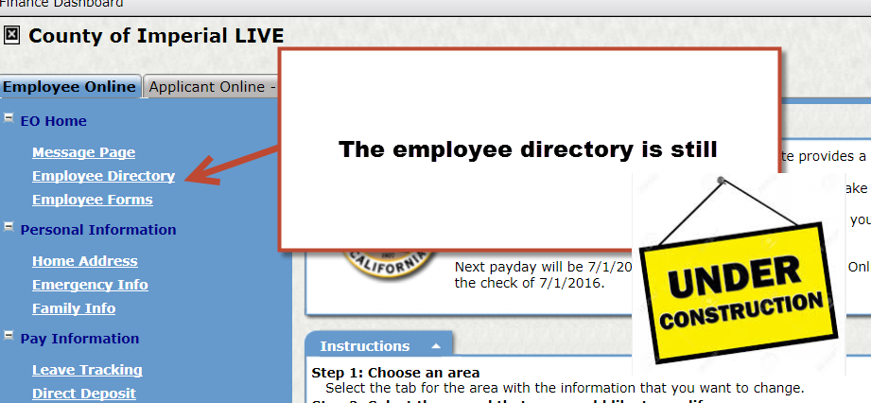
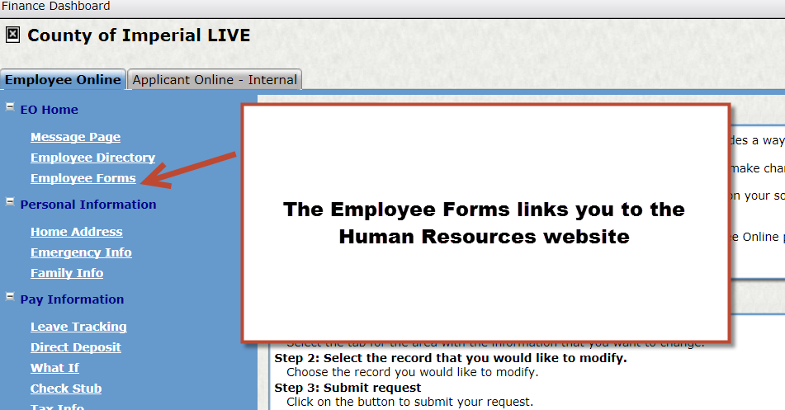
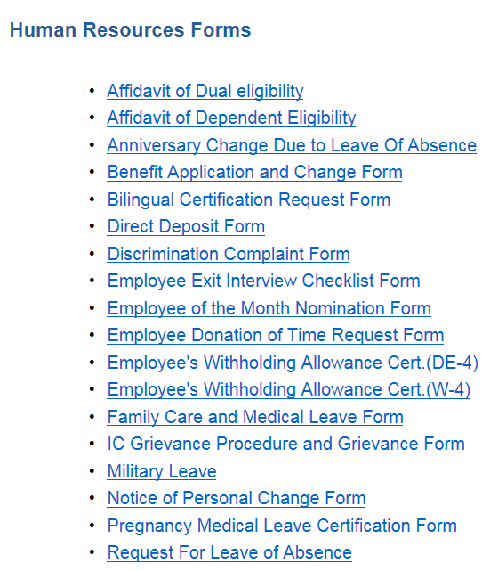
EO HOME
Employee Directory & Employee Forms

Slide 8
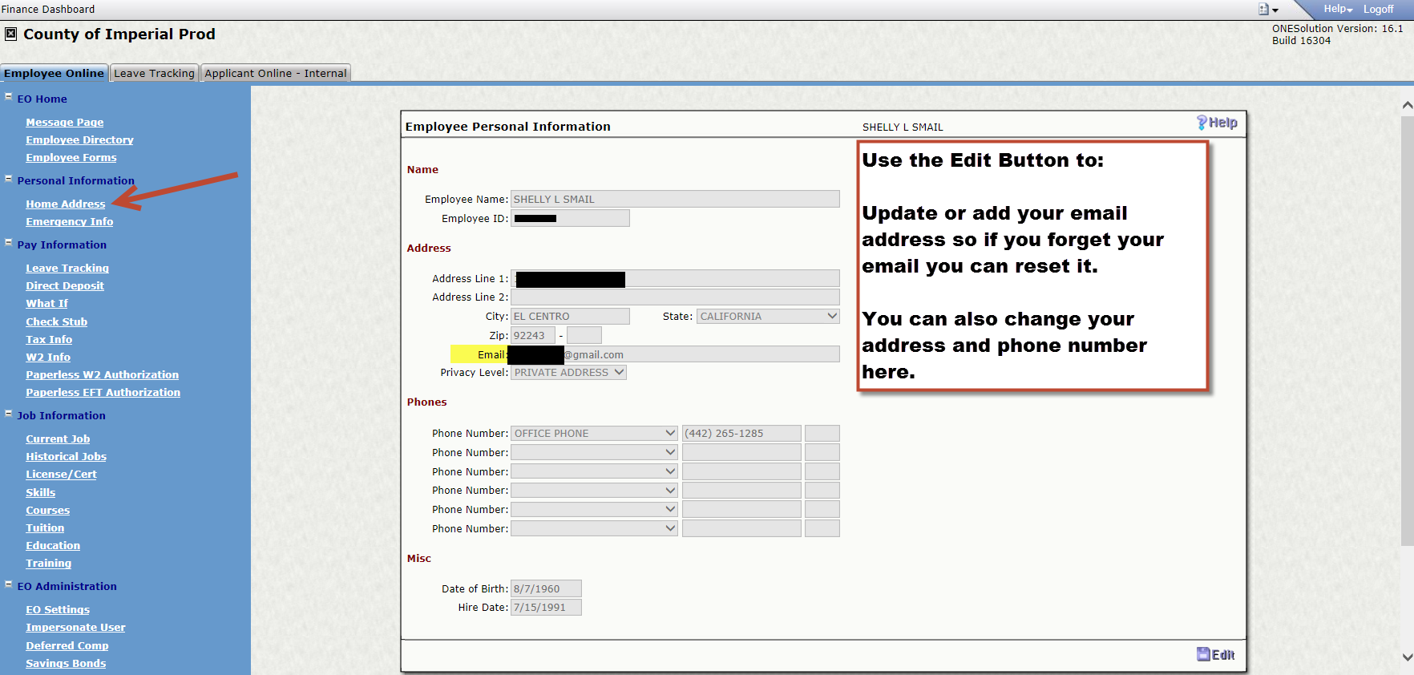
Personal Information
Home Address

Slide 9
Personal Information Cont.
Emergency Info can be updated or edited from these screens:
Double click on a name to edit or select Add button for additions

Slide 10
Pay Information
Leave tracking
On this link you can select a leave type such as vacation or sick then select the years of detail for the balance requested and you can review your accruals.

Slide 11
Pay Information
Direct Deposit
Add new banking information and Close your direct deposit here, click the Add or close buttons to make changes.

Slide 12
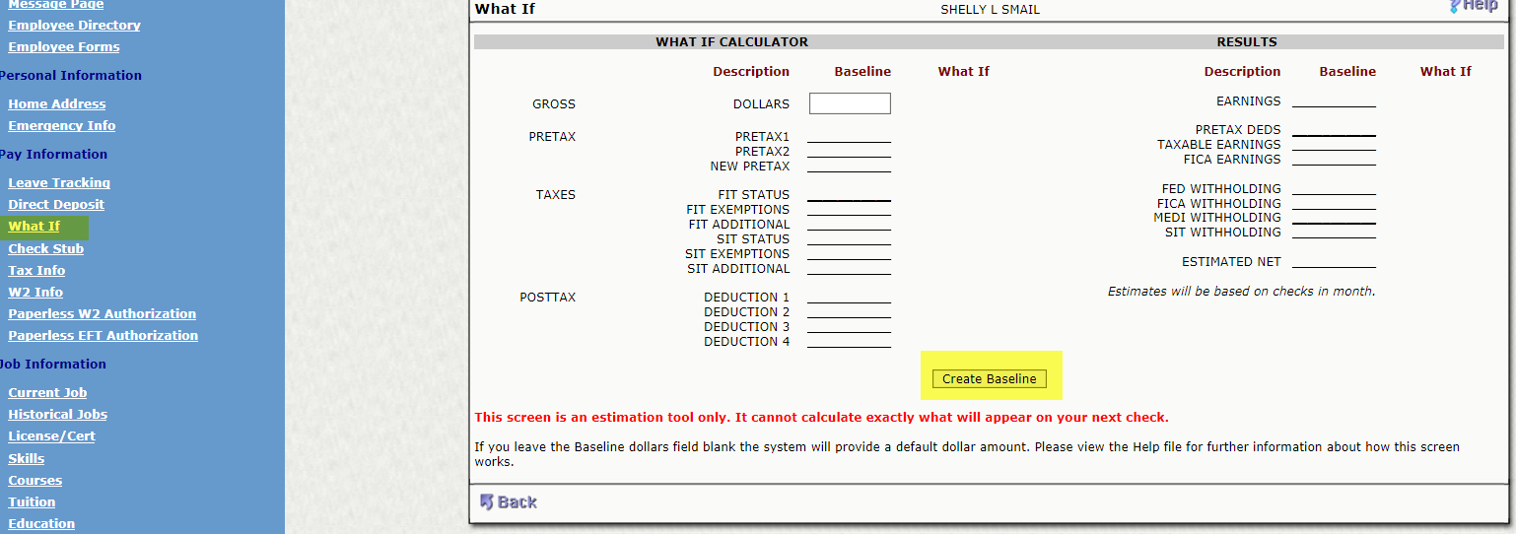
Pay Information
What If Calculator
Ever wonder what would happen if you changed your dependents or added more to your deferred comp?
You can find out with the What If Calculator.
Create a Baseline then on the right enter your what if changes and it will give you an estimate of your net pay.

Slide 13
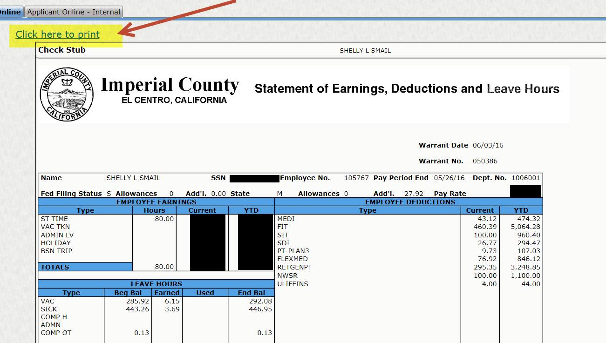
Pay Information
Check Stubs
Now as soon as payroll is run you can log in and get your check stub! We have them starting from the end of April to current just select the one you want to print and click on the “Click here to print”

Slide 14
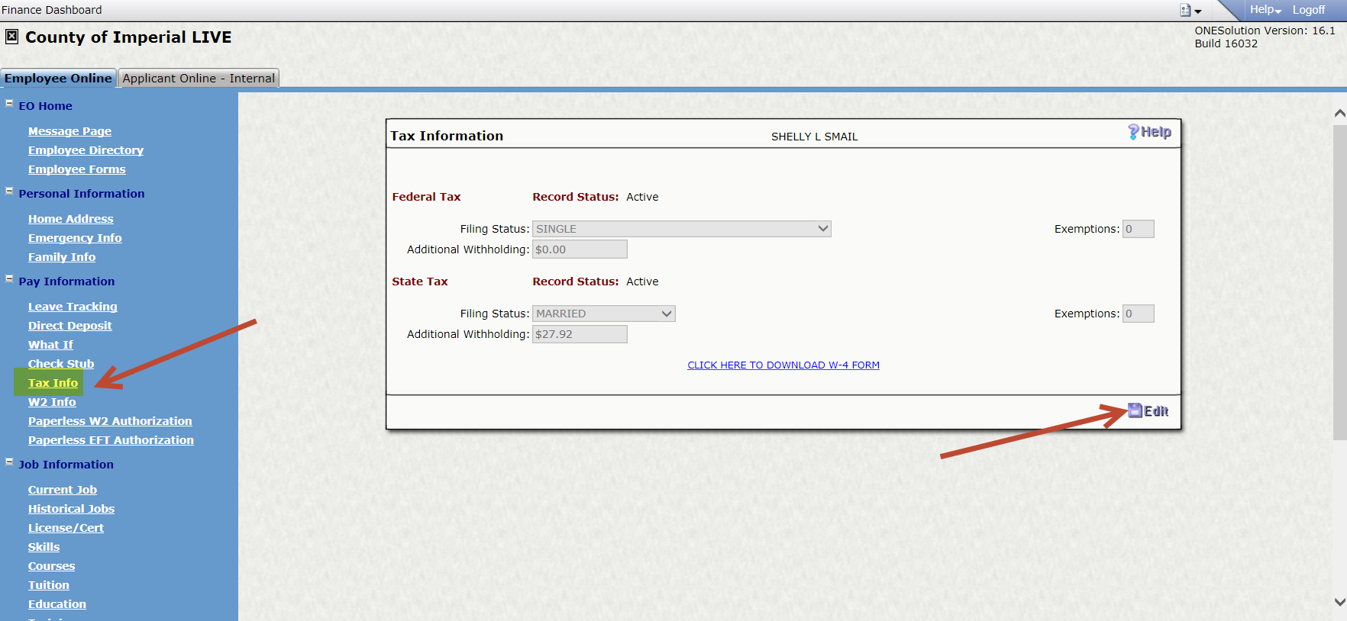
Pay Information
Tax Info
On the Tax Info screen you can:
Review your withholdings,
Edit your withholdings,
&
Link to the IRS to print a W-4 Form
You will no longer be required to submit a W-4 Form to change your taxes!

Slide 15
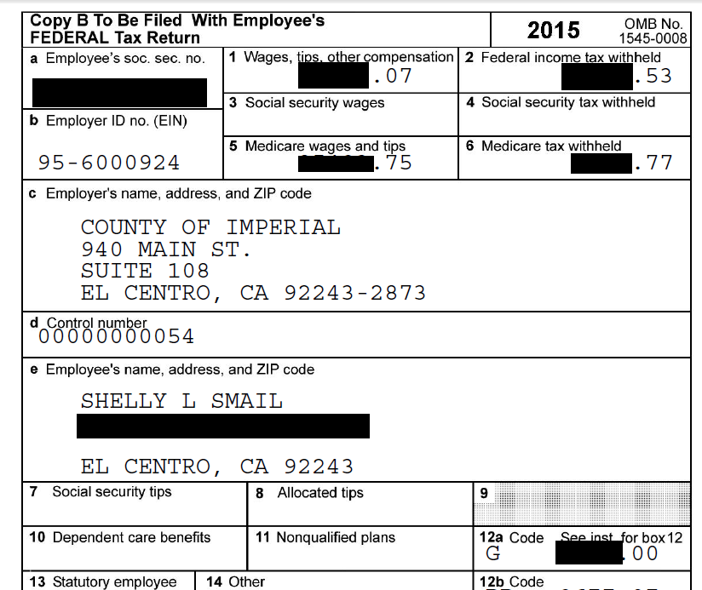
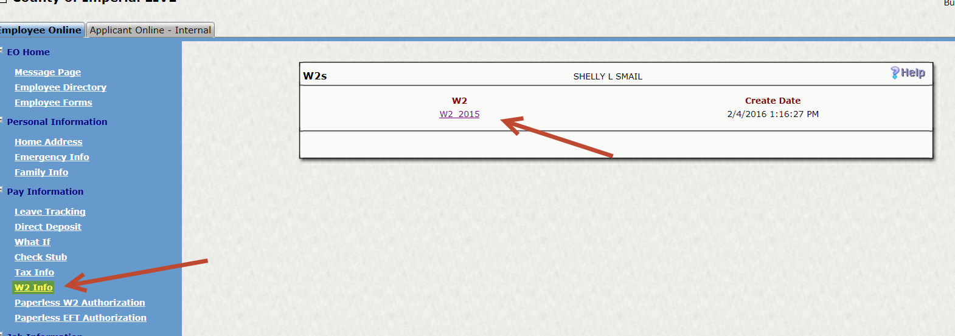
Pay Information
W2 Info
You can go online to print your W-2, simply click on the W2 info link and select the year you want to print and you will have your copy and will be ready to file your taxes. This will be updated as soon as the Auditors Office is has them completed.

Slide 16
Pay Information
Paperless W2 Authorization & Paperless EFT Authorization
Go Green!
You can now request to have your W2 and your EFT electronically.
Check the consent box and hit save and your EFT & W2 will no longer print. Simply log on and view or print them when and if you need them.

Slide 17
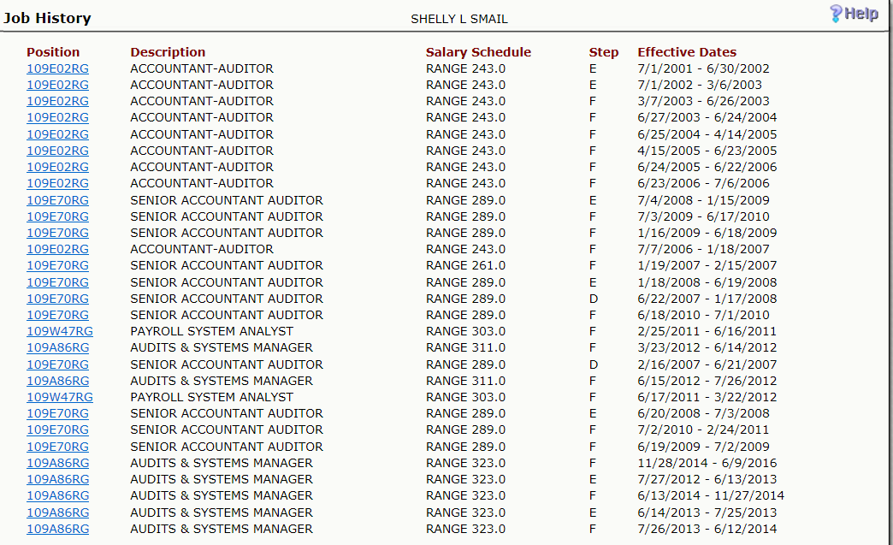
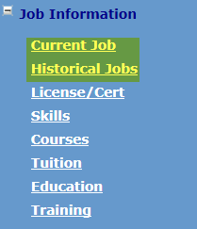
Job Information
Current Job & Historical Jobs
On these two links you can review your current position along with rates of pay.
On the Historical Jobs you can review your jobs history.

Slide 18
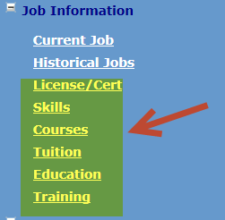
Job Information
Other links
The other links on the Job Information portion of employee online will be updated at a later date

